Slide 1

Credit Card Clients Dataset
Group 2
Members:
Martin Aguirre
Vishruth Acharya
Yuvaraja Reddy Ambati
Varun Namala
Prasanth Chowdary Yanamandala

Slide 2
Source, Objective & Data Prep
Dataset source:
https://www.kaggle.com/datasets/uciml/default-of-credit-card-clients-dataset
This dataset contains information on default payments, demographic factors, credit data, history of payment, and bill statements of 30,000 credit card clients in Taiwan from April 2005 to September 2005.
Business Objective:
We aim to assess 4 different algorithms to measure the model's ability to determine if a credit card client will default on their payments based on the independent variables provided (demographic factors, credit data, history of payment, etc.). We will use this model to predict if the client will default on payment of the credit card bill for the following month.
Data Preparation:
For feature selection, we have filtered some features based on a few statistical techniques like step function, removing correlated features.
For null values, if any, we replaced them with the mean value of that column for numerical columns and “new” value for categorical columns.
For outliers if any, we clipped them with lower capping of 0.1 and upper capping of 0.99.
We also transformed all the categorical columns into dummy columns i.e., converted them to numerical columns to get better results.

Slide 3
Understanding the variables
Variable | Definition
ID | ID of each client
LIMIT_BAL | Amount of given credit in NT dollars (includes individual and family/supplementary credit
SEX | Gender (1=male, 2=female)
EDUCATION | (1=graduate school, 2=university, 3=high school, 4=others, 5=unknown, 6=unknown)
MARRIAGE | Marital status (1=married, 2=single, 3=others)
AGE | Age in years
PAY_0 | Repayment status in September, 2005 (-1=pay duly, 1=payment delay for one month, 2=payment delay for two months, … 8=payment delay for eight months, 9=payment delay for nine months and above)
PAY_2 | Repayment status in August, 2005 (scale same as above)
PAY_3 | Repayment status in July, 2005 (scale same as above)
PAY_4 | Repayment status in June, 2005 (scale same as above)
PAY_5 | Repayment status in May, 2005 (scale same as above)
PAY_6 | Repayment status in April, 2005 (scale same as above)
BILL_AMT1 | Amount of bill statement in September, 2005 (NT dollar)
BILL_AMT2 | Amount of bill statement in August, 2005 (NT dollar)
BILL_AMT3 | Amount of bill statement in July, 2005 (NT dollar)
BILL_AMT4 | Amount of bill statement in June, 2005 (NT dollar)
BILL_AMT5 | Amount of bill statement in May, 2005 (NT dollar)
BILL_AMT6 | Amount of bill statement in April, 2005 (NT dollar)
PAY_AMT1 | Amount of previous payment in September, 2005 (NT dollar)
PAY_AMT2 | Amount of previous payment in August, 2005 (NT dollar)
PAY_AMT3 | Amount of previous payment in July, 2005 (NT dollar)
PAY_AMT4 | Amount of previous payment in June, 2005 (NT dollar)
PAY_AMT5 | Amount of previous payment in May, 2005 (NT dollar)
PAY_AMT6 | Amount of previous payment in April, 2005 (NT dollar)
default.payment.next.month | Default payment (1=yes, 0=no)

Slide 4
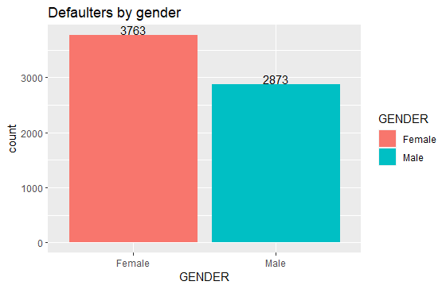
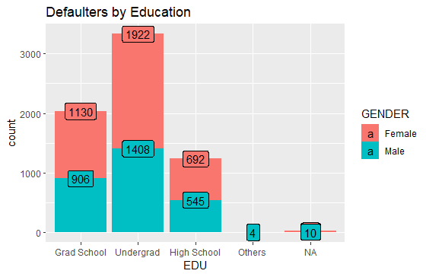
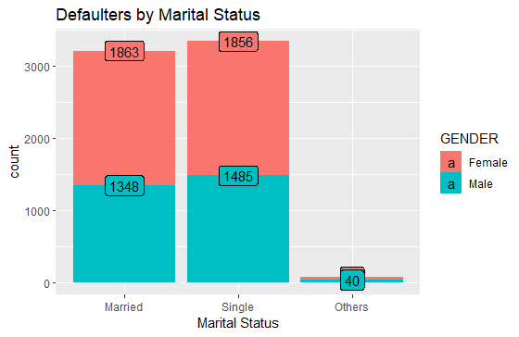
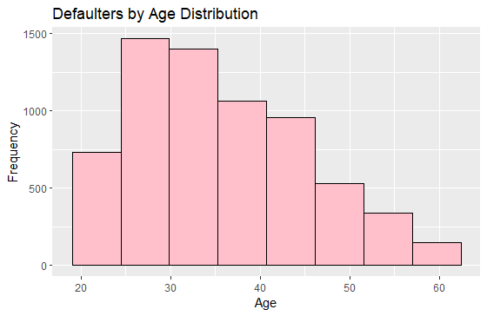
Preliminary Data Analysis
#Checking defaulters by gender, education, marital status, and age to get an initial picture of our data.
,

Slide 5
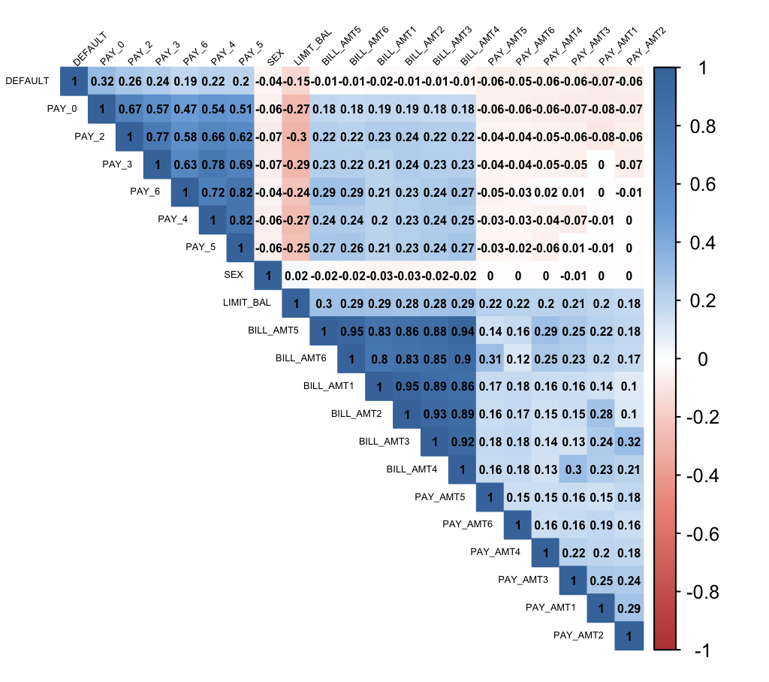
Correlation heatmap
#Changing column name of the dependent variable and changing its data type.
colnames(df)[colnames((df)) == "default.payment.next.month"] = "DEFAULT"
df$DEFAULT = as.numeric(df$DEFAULT)
#Plotting Correlation Matrix
r = cor(df[-c(3, 4, 5, 26, 27)], method = 'pearson')
col_gd <- colorRampPalette(c("#BB4444", "#EE9988", "#FFFFFF", "#77AADD", "#4477AA"))
corrplot(r, method = "color", col = col_gd(200),
type = "upper", order = "hclust",
addCoef.col = "Black",
tl.col = "black", tl.srt = 45, number.cex = 0.5,tl.cex = 0.4)
The dark blue shade denotes a strong positive association between variables and the dark red shade denotes a strong negative association between variables.

Slide 6
Data Preparation
#Changing column types to factors so that algorithm does not take our nominal values as ordinal values.
df$SEX<- as.factor(df$SEX)
df$EDUCATION<- as.factor(df$EDUCATION)
df$MARRIAGE <- as.factor(df$MARRIAGE)
#Scaling all independent variables.
df[-c(24)] <- df[-c(24)]%>%
mutate(across(where(is.numeric), scale))
df$DEFAULT <- as.factor(df$DEFAULT)
df$PAY_0 = as.factor(df$PAY_0)
df$GENDER = ifelse(df$SEX == 1, "Male", "Female")

Slide 7
Modeling techniques to be assessed
1. Logistic Regression
the logistic model (or logit model) is a statistical model that models the probability of an event taking place by having the log-odds for the event be a linear combination of one or more independent variables. In regression analysis, logistic regression (or logit regression) is estimating the parameters of a logistic model (the coefficients in the linear combination).
2. Random Forest
Random forests or random decision forests are an ensemble learning method for classification, regression and other tasks that operate by constructing a multitude of decision trees at training time and outputting the class that is the mode of the classes (classification) or mean/average prediction (regression) of the individual trees.
3. Boosting Model
Boosting is an ensemble modeling technique that attempts to build a strong classifier from the number of weak classifiers. It is done by building a model by using weak models in series.
4. Neural Networks
A neural network is a network or circuit of biological neurons, or, in a modern sense, an artificial neural network, composed of artificial neurons or nodes. Thus, a neural network is either a biological neural network, made up of biological neurons, or an artificial neural network, used for solving artificial intelligence (AI) problems.

Slide 8
Model Building
Logistic Regression Model (LR)
#Fitting the training data to a logistic regression model
logit.reg <- glm(DEFAULT ~ ., data = trainset, family = "binomial")
summary(logit.reg)
# use predict() with type = "response" to compute predicted probabilities.
logit.reg.pred <- predict(logit.reg, testset, type = "response")
#Converting probabilities to 0 and 1 using 0.5 as threshold value.
logit.reg.pred.classes <- ifelse(logit.reg.pred > 0.5, 1, 0)
Random Forest Model
#Checking important variables
classifier.rf = randomForest(DEFAULT ~., data = trainset, ntree = 50)
varImpPlot(classifier.rf)
#Summary of RFM
summary(classifier.rf)
#Prediction using RFM.
our.predict.rf = predict(classifier.rf, newdata = testset, type = "response")

Slide 9
Boosting Model
library(adabag)
set.seed(1)
boost <- boosting(DEFAULT ~ ., data = trainset, mfinal = 20)
#Prediction using BM.
pred <- predict(boost, testset)
Neural Networks
nn <- neuralnet(DEFAULT ~ PAY_0 + SEX + BILL_AMT1 + PAY_AMT1 , data = trainset, linear.output = F, hidden = 2, learningrate = 0.05)
#plotting the neural network
plot(nn, rep="best")
#predicting default payments in validation dataset using above defined model
nn.pred <- predict(nn, testset, type = "response")
# cut off value of probability set to 0.5
nn.pred.classes <- ifelse(nn.pred > 0.5, 1, 0)

Slide 10
Data Splitting
#Splitting data into training and testing dataset.
#Validation dataset
#Considering an 70/30 split
train_split <- 0.7
#Creating the split
train_index <- createDataPartition(test_data$DEFAULT,p = train_split, list = FALSE,times = 1)
training_set <- test_data[train_index,]
test_dataset <- test_data[-train_index,]
#Fitting the training data to a logistic regression model
logit.reg <- glm(DEFAULT ~ ., data = training_set, family = "binomial")
summary(logit.reg)

Slide 11
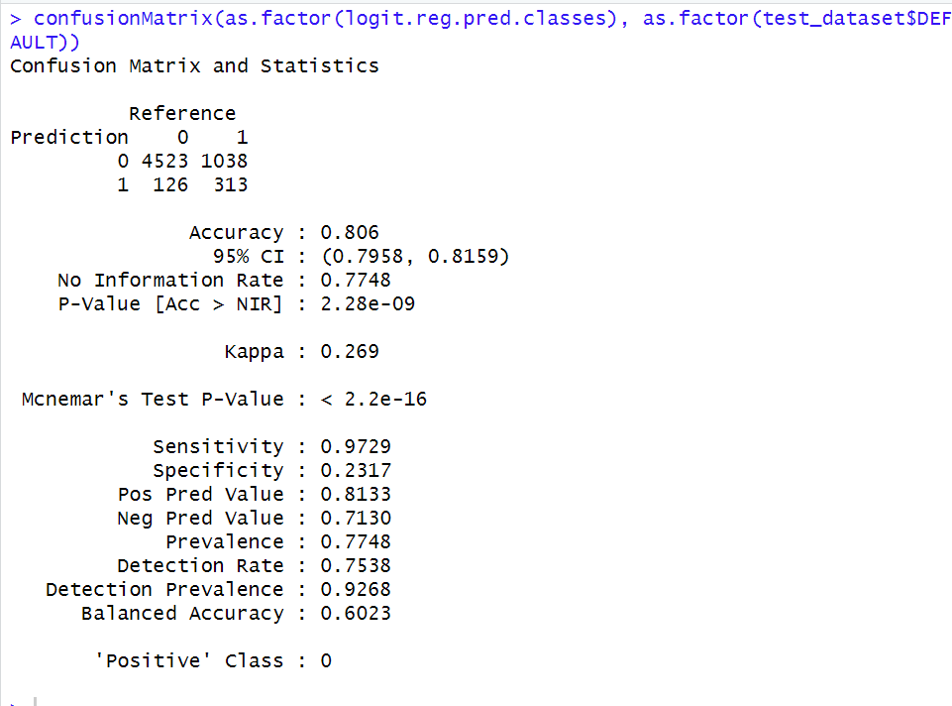
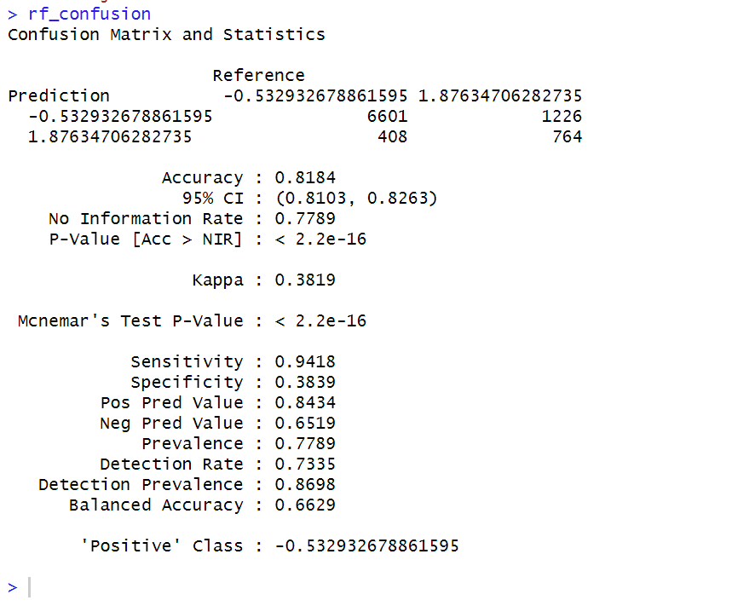
Model Evaluation
Logistic Regression Model
confusionMatrix(as.factor(logit.reg.pred.classes), as.factor(testset$DEFAULT))
Random Forest Model
rf_confusion <- confusionMatrix(as.factor(our.predict.rf), as.factor(testset$DEFAULT))

Slide 12
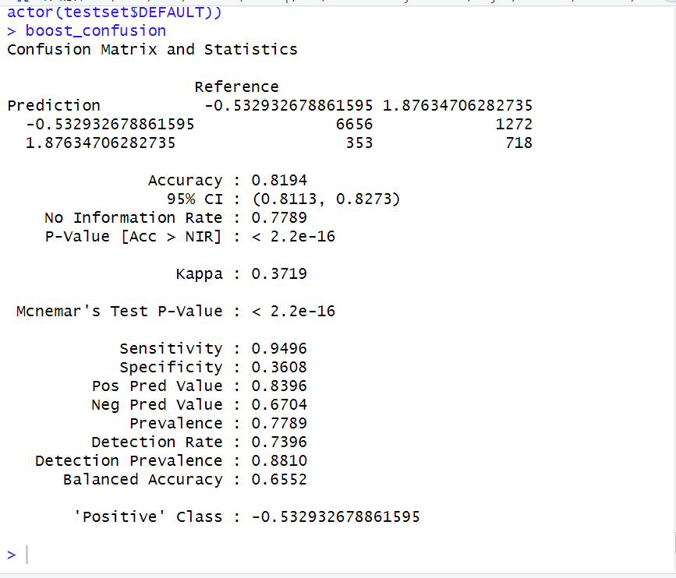
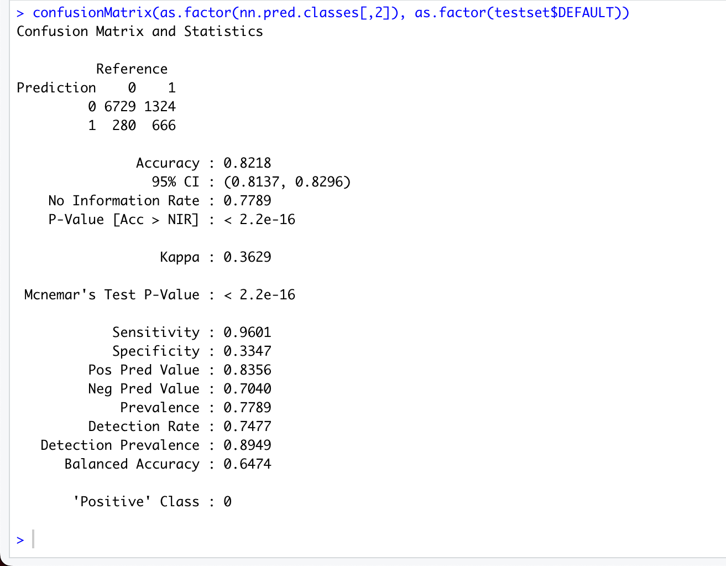
Boosting Model
Neural Networks
confusionMatrix(as.factor(nn.pred.classes[,2]), as.factor(testset$DEFAULT))
boost_confusion <- confusionMatrix(as.factor(pred.boost$class), as.factor(testset$DEFAULT))boost_confusion

Slide 13
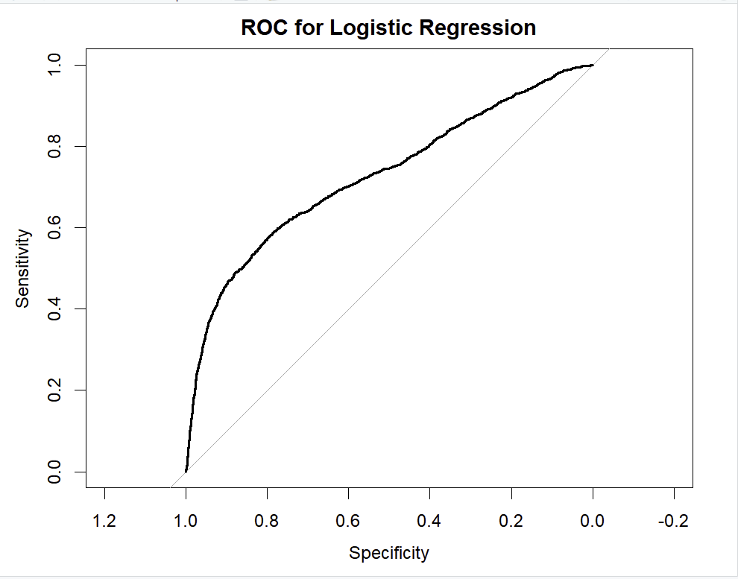
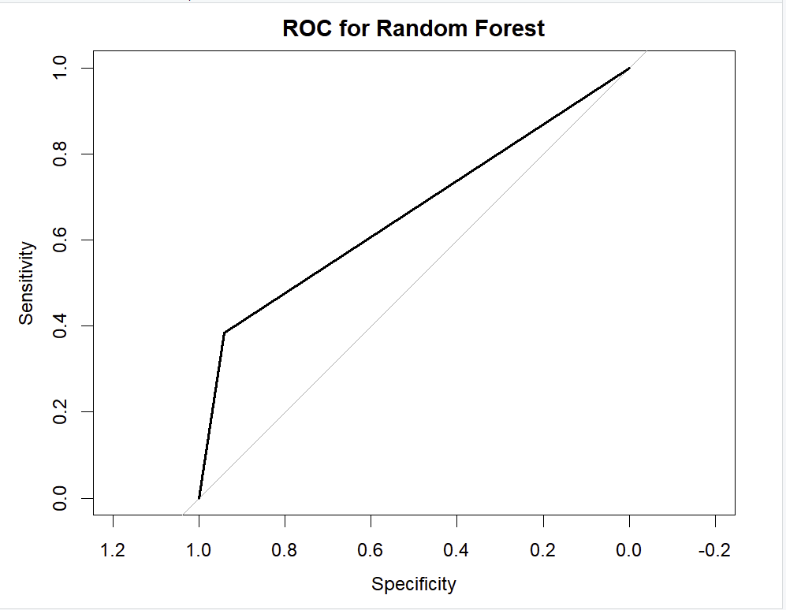
ROC Curve & AUC
Logistic Regression
logis <- glm(DEFAULT ~ ., data=trainset, family=binomial)
# ROC Curve for Logistic Regressionroc_lr <- roc(response = testset$DEFAULT, predictor = as.numeric(logit.reg.pred))plot(roc_lr, main="ROC for Logistic Regression")auc(roc_lr)
Random Forest
# ROC Curve for Random Forestroc_rf <- roc(response = testset$DEFAULT, predictor = as.numeric(our.predict.rf))plot(roc_rf, main="ROC for Random Forest")auc(roc_rf)
Area under the curve: 0.7267 - 72.6%
Area under the curve: 0.6629 - 66.29%

Slide 14
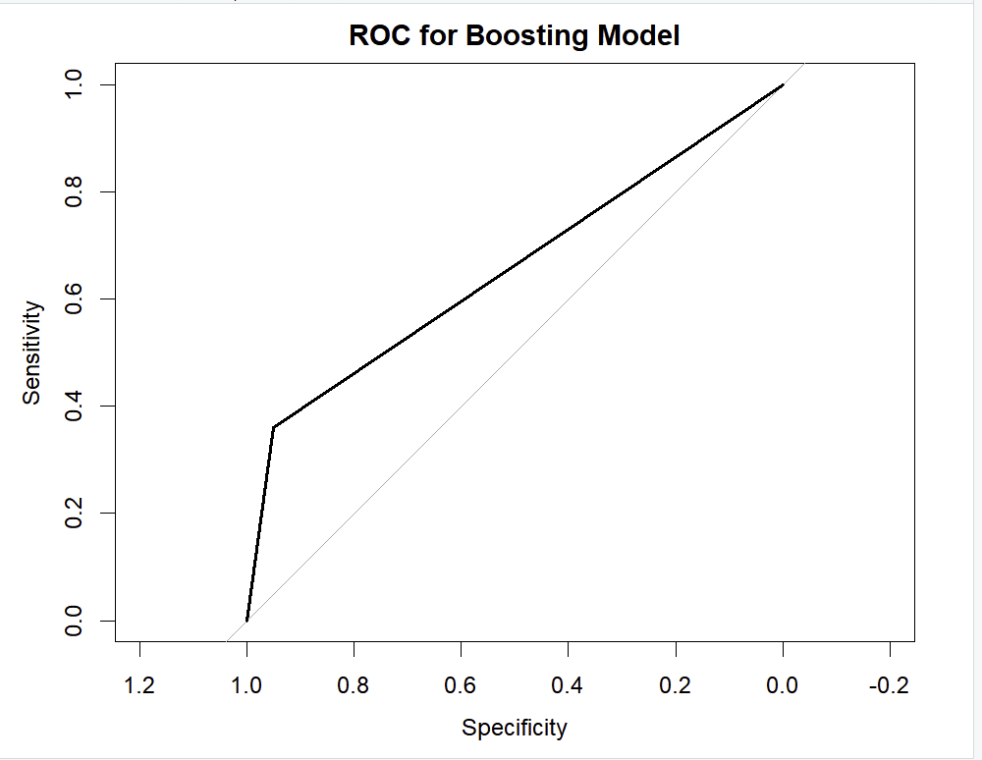
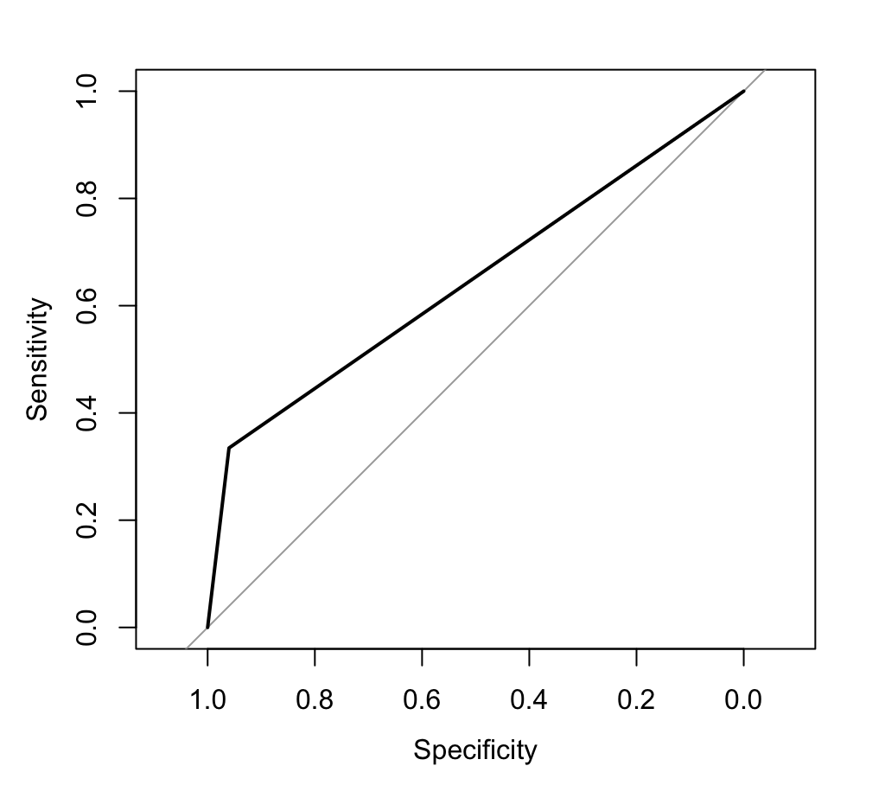
Boosting Model
roc_boost <- roc(response = testset$DEFAULT, predictor = as.numeric(pred.boost$class))plot(roc_boost, main="ROC for Boosting Model")auc(roc_boost)
Neural Networks:
roc_nn <- roc(response = testset$DEFAULT, predictor = as.numeric(nn.pred.classes))plot(roc_nn, main="ROC for Neural Network")auc(roc_nn)
Area under the curve: 0.6552- 65.52%
Area under the curve: 0.6474 64.74%

Slide 15
Finding & Conclusion
Our business goal is to identify people who will default on their payments in the future and avoid providing them with credit cards.
Model | Accuracy | AUC
Logistic Regression | 80.6% | 72.846%
Random Forest | 81.84% | 66.29%
Boosting | 81.94% | 65.52%
Neural Network | 82.18% | 64.74%
After comparing the accuracy score, Neural Networks has the highest accuracy and is doing the best job for us, and AUC scores for these models we might conclude that Logistic Regression is doing the best job for us. There is a catch, though.
We want our model to classify people as precisely as possible. If our model classifies a “Defaulter as a Non-Defaulter” then this would impact our business more gravely as compared to “Non-Defaulter as a Defaulter”.
In other words, we want our “False positive rate” as minimal as possible.
So, comparing the model using “False Positive Value”
Model | False Positives
Logistic Regression | 1038
Random Forest | 1226
Boosting | 1272
Neural Network | 1324
If we look at it this way, Logistic Regression would be the one we would want to proceed further with. Also, in the future, our goal should be to focus on improving this value.

Slide 16
THANK YOU!
GROUP 2

